Slide 1


Electronic Case Reporting
with Antibiotic-Related Clinical Decision Support
EHR Team: Maggie Dorr, Hao "Chris" Fang, Elaine Limqueco, Yiliang "Spike" Ma, B. Kevin Ramada
December 11th, 2018
Notes:
Teams will present their projects using slides in 15 minute oral presentation. The presentation should include:
Background. Describe the problem or area being addressed.
Data used. What data did you use? How was it obtained? What are its limitations?
Use cases. How users will interact with your system in a way that addresses the problem area.
Demo. Demonstrate your software.
Design. Describe the components and how they interact to accomplish the use cases.
Project Structure. Show the structure of your github repository.
Lessons learned and future work.
You should post a PDF of your presentation in the docs folder of your project.

Slide 2
Presentation Outline
Background
Data Sources
Use Cases
Design
Demonstration
Future Work

Slide 3
Background
Notes:
By a show of hands, before this class, how many people had heard of notifiable conditions?
What about case reporting or electronic case reporting?

Slide 4
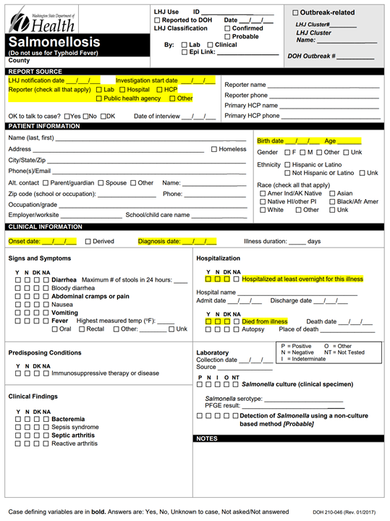
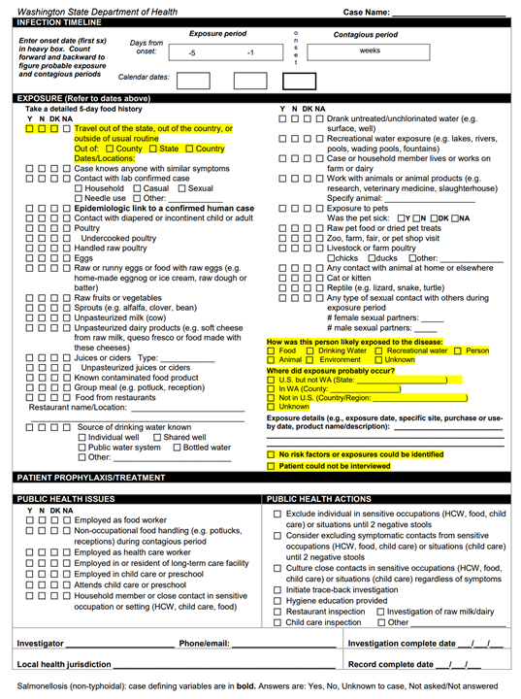
Notes:
Background. Describe the problem or area being addressed.
In order to track the health of a population, states are required to submit a case report form for every positive incidence of a notifiable condition,
After which a case investigation in initiated
Super time intensive for everyone
Picture Source: WA DOH (https://www.doh.wa.gov/Portals/1/Documents/5100/210-046-ReportForm-Salmonella.pdf)

Slide 5
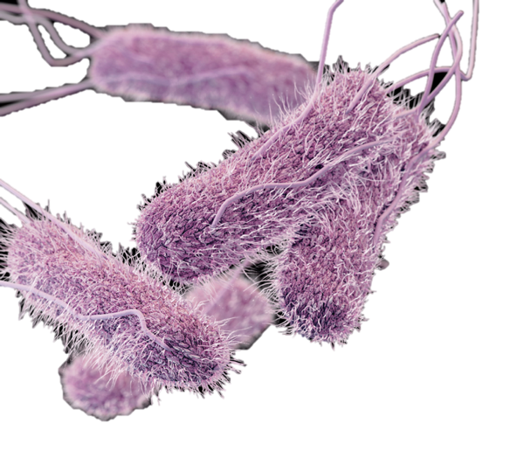
Antibiotic Resistance
Antibiotic resistance is a growing threat
Primarily caused by antibiotic misuse
Many infections, such as salmonellosis, are becoming resistant
To prevent and treat antibiotic resistance, physicians and patients need to be aware of local resistance patterns
Currently no means to incorporate antibiotic resistance tracking with treatment planning
Notes:
Background. Describe the problem or area being addressed.

Slide 6
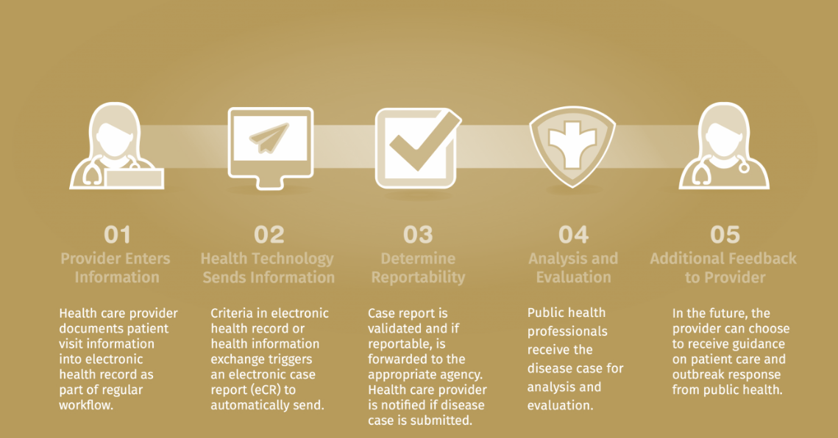
Notes:
A large national effort called Digital Bridge has decided to attempt to tackle the creation of an eCR system. We’ve decided to focus our project on two aspects of their project. [CLICK] First, we’re mimicking the process of automatically determining cases using predetermined trigger codes. We then develop a case report that combines both the required information for a case report, as well as a clinical decision support system to notify clinicians about antibiotic resistance patterns in their area. [CLICK AGAIN] We have a UI where a Public Health professionals or Clinicians can query a specific patient and see their report with condition and antibiotic relevant information
Picture Source: Digital Bridge Informational Ppt (slides not publicly available)

Slide 7
Data Sources

Slide 8
MIMIC III v1.4
Medical Information Mart for Intensive Care III
NARMS
National Antimicrobial Resistance Monitoring System
PHIN VADS Trigger Codes
Public Health Information Network Vocabulary Access & Distribution System
De-identified health related data
40,000 patients who stayed in Beth Israel Deaconess Medical Center critical care units between 2001-2012
Developed by the MIT Lab for Computational Physiology
De-identified health related data
Tracks antimicrobial susceptibility of enteric (intestinal) bacteria found in ill people, retail meats, and food animals
Developed by a collaborative effort between state and local public health departments and universities, the FDA, the CDC, and the USDA
Used to identify cases
Notes:
Data used. What data did you use? How was it obtained? What are its limitations?
Bonus: We’re also using PHIN VADS trigger codes to determine eligibility of cases

Slide 9
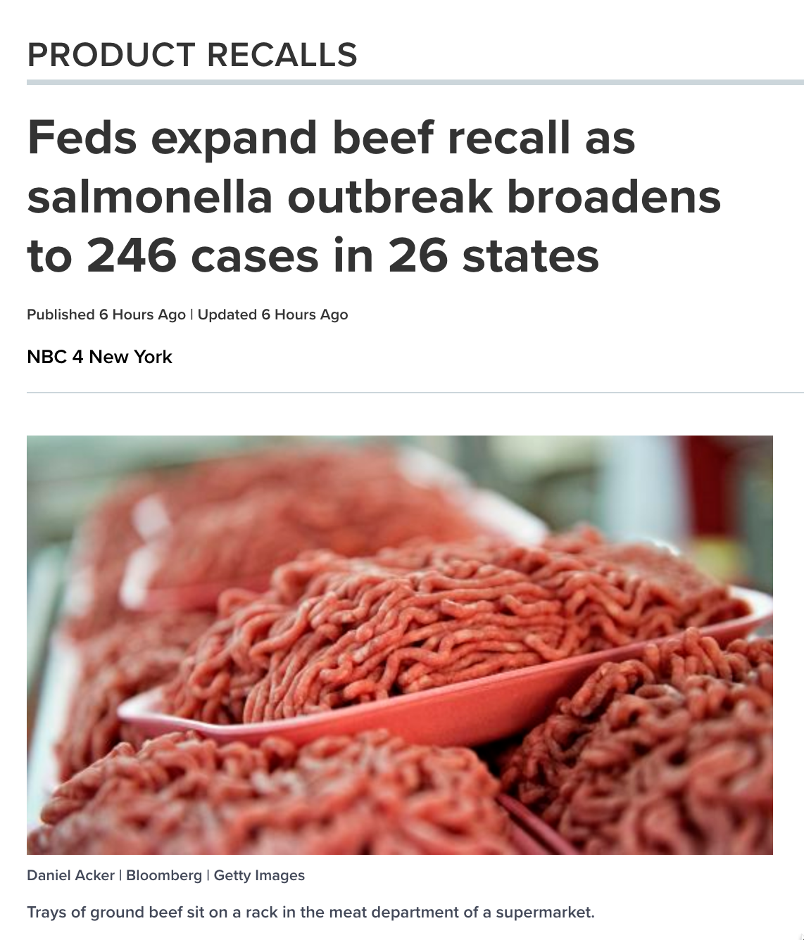

Slide 10
Use Cases

Slide 11

End Users
Public Health Officials
Guide Policy Decisions
Public Health Researchers
Assist research
Physicians
Guide Treatment Decisions
Notes:
Use cases. How users will interact with your system in a way that addresses the problem area.

Slide 12
Design

Slide 13
Structure
EHRTeam
__init__.py
database_build.py
MainWindow.py
Narm’s processed.csv
Output_pdf.py
QtUI_rev.py
Quer.py
Query_all_rows.py
Sql_import.py
Test_file.csv
test_query.py
Data
README.md
Software license
Setup.py
Docs
Software Components
Function specification
Notes:
Project Structure. Show the structure of your github repository.

Slide 14

Create Database≈
MIMIC Database
PHIN VADS
SQL to CSV
sql_import.py
MIMIC_tableN
MIMIC_table1
NARMS
SQL to CSV
database_build.py
Notes:
Design. Describe the components and how they interact to accomplish the use cases.

Slide 15
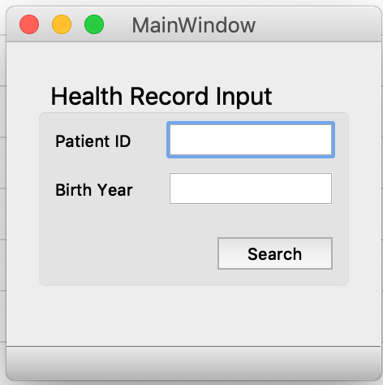
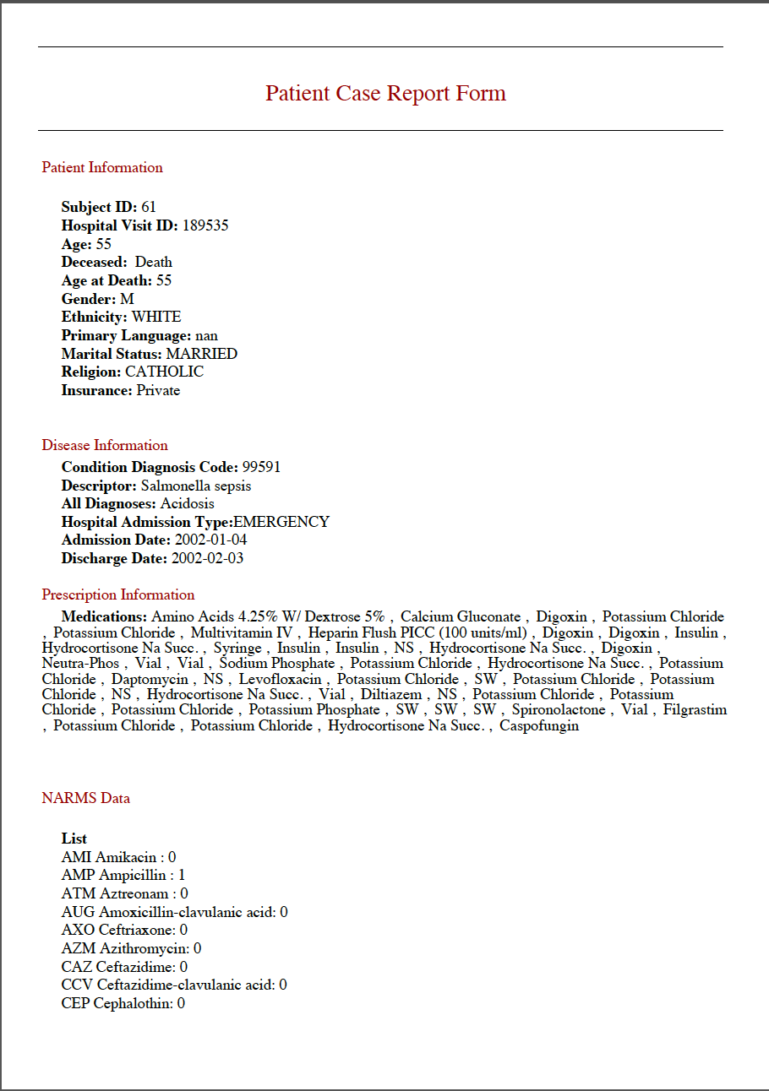

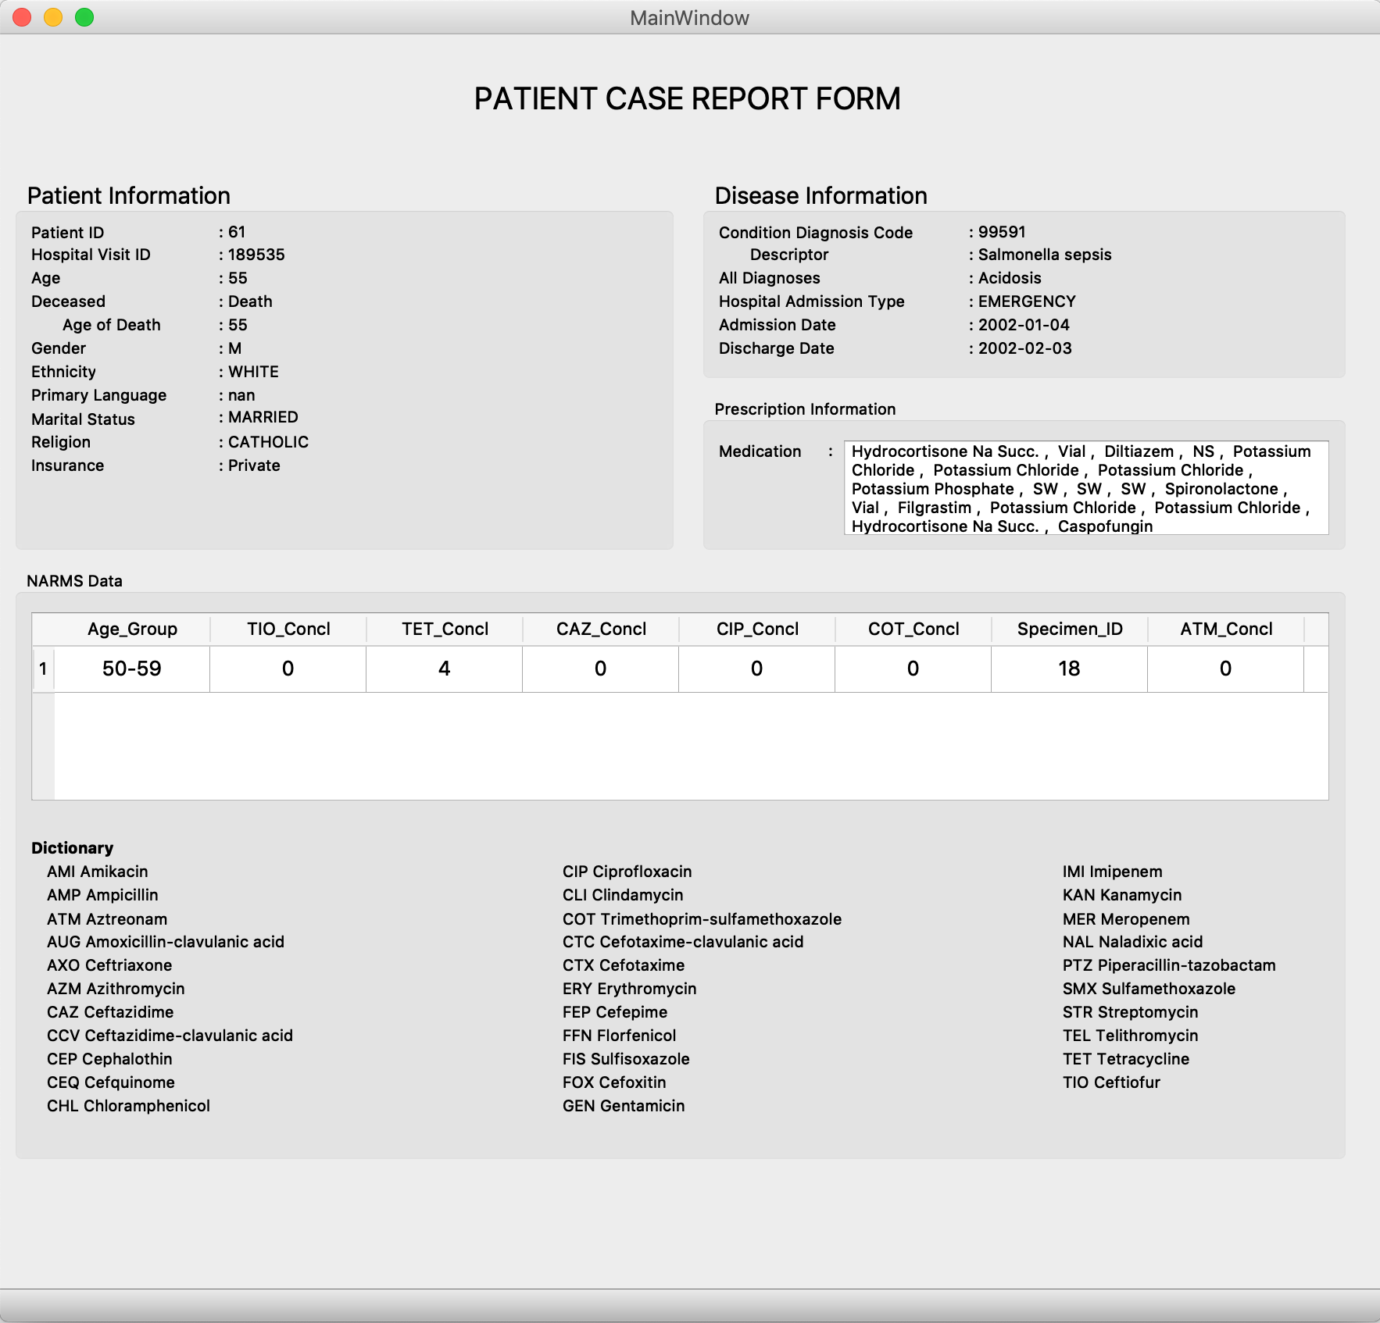
User Interface
MainWindow.py
User Input:
query.py quer_all_rows.py
NARMS
Recent Antibiotic Resistance
Patient Records
output_pdf.py
Notes:
Design. Describe the components and how they interact to accomplish the use cases.

Slide 16
Demonstration
Notes:
K: Hey, what are you doing here? You supposed to get some rest due to your salmonella infection.
C: I still feel not so good, Doc.
K: It can’t be! I gave you the best medicine ever like a week ago.
C: Maybe i’m too weak for the salmonella, but still strong enough to beat the vaccine.
K: … okay. Let me check your record. Luckily, we just bought a new electronic case report system from UW students.
C: Cool, can I see it?
K: Yeah sure. What is your Patient ID?
C: 61
K: Age?
C: 24
K: That’s more than enough. Then, we can see your report here. (explain every part, esp. medication). It looks like there are some cases in Massachusetts, people in range of ... have resistance to this antibiotic you have taken.
C: So can you give me a new prescription?
K: Yes! This is the second best medicine without any history of resistance case. You should be fine.
C: Thanks Doc! Can I get the copy of the health record as well?
K: Ofc! The system also generates a pdf version of it. I will also send it to your insurance …
C: Alright, see you Doc. And by the way, what is the amazing electronic case report system are you using?
K: EHR

Slide 17

Notes:
Design. Describe the components and how they interact to accomplish the use cases.

Slide 18

Notes:
Design. Describe the components and how they interact to accomplish the use cases.

Slide 19
Notes:
Design. Describe the components and how they interact to accomplish the use cases.

Slide 20
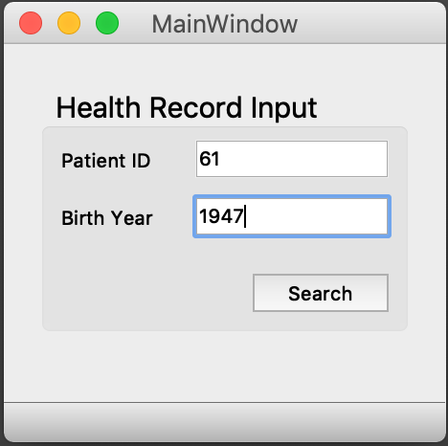
Notes:
Design. Describe the components and how they interact to accomplish the use cases.

Slide 21
Notes:
Design. Describe the components and how they interact to accomplish the use cases.

Slide 22
Notes:
Design. Describe the components and how they interact to accomplish the use cases.

Slide 23
Lessons Learned & Future Work

Slide 24

Lessons Learned
Using large databases is very resource intensive
Memory is beautiful
AWS, Microsoft Azure
Better management
Split your dataframe and query separately
Clear and definite workflow
Upstream, downstream
Programming connection
Notes:
Lessons learned and future work.

Slide 25

Licensing & Future Work
GNU General Public License:
Open access to encourage development and adoption of electronic health technology and antibiotic use monitoring
Future Improvements
Automate filling out report forms
Incorporate recommendations for alternative antibiotic treatment plans from UptoDate
Notes:
Lessons learned and future work.

